Slide 1
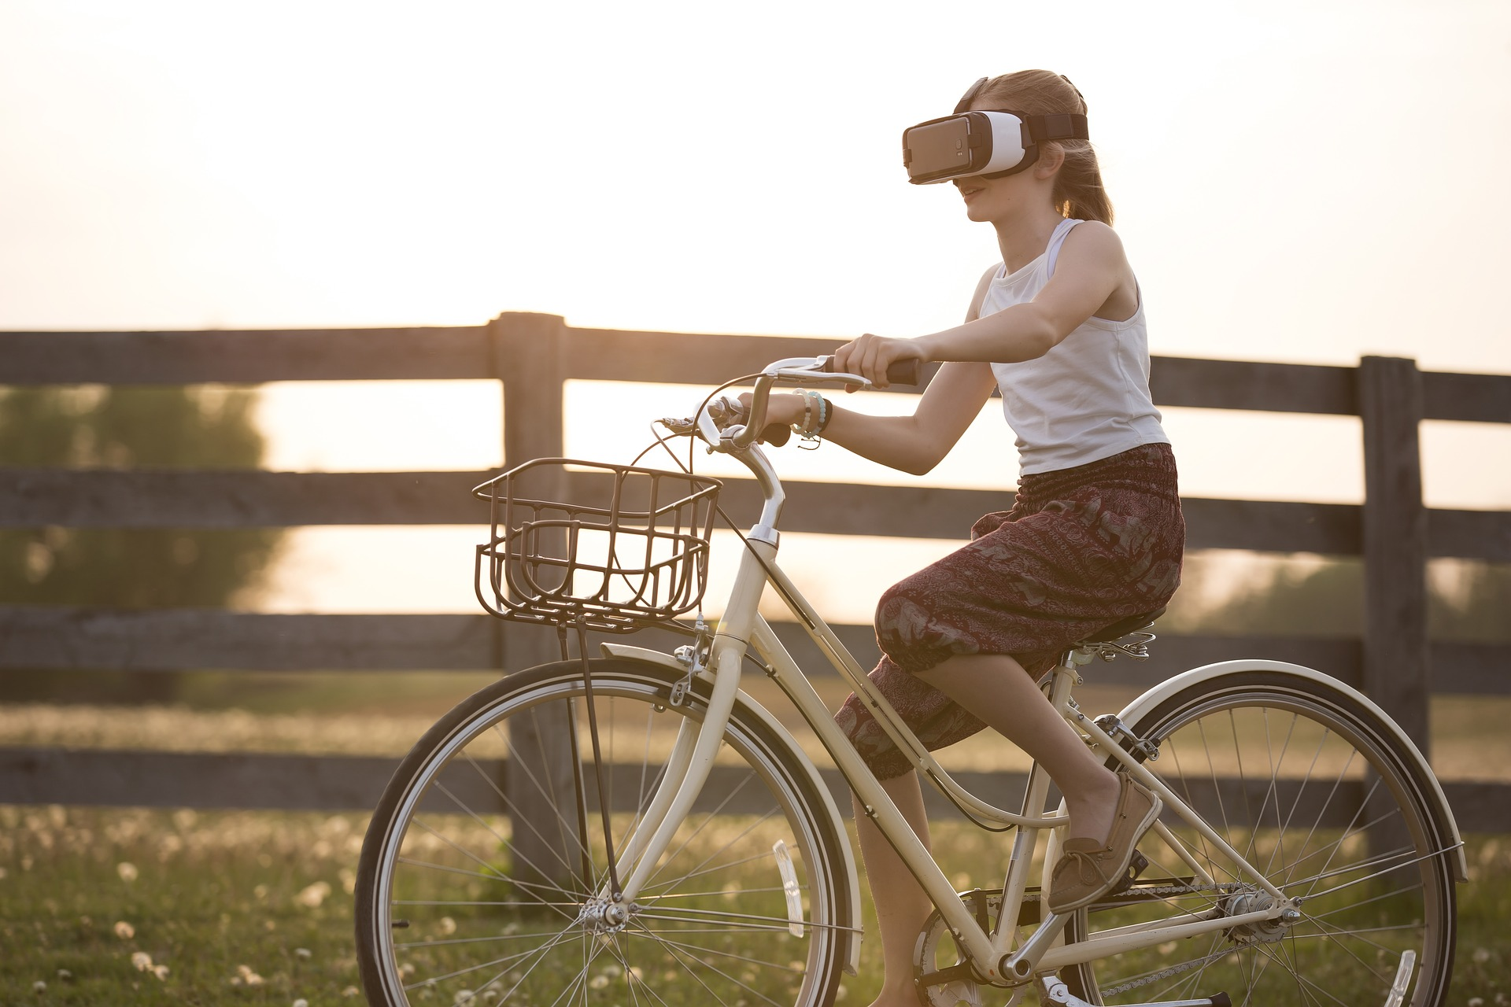
Back to Nature
Project Review and Feedback
Research Practicum
IDS6916
Andres Hanchi
Markus Loennig
Marc Mailloux

Slide 2
Topic / Purpose Statement
The aim of our research is to study the length needed to show effects of Nature exposure through Virtual Reality (VR) in regards to Attention Restoration Theory (ART)
Research in ART has shown the positive effects that nature can have on attention restoration
During these studies, the researchers arbitrarily decided the length of exposure time (most researchers used 15 minutes)
Our goal is to restore one’s attention in less than the standard 15 minutes used in previous studies.

Slide 3
Introduction
Today’s fast pace world can have a negative effect on attention
Directed attention plays a large role in productivity and mental stability
Several studies based on Attention Restoration Theory (ART) have validated the positive effects that nature and/or nature scene exposure can have on one’s attention.
Understanding the time needed to restore attention is vital

Slide 4
Related Works / Literature Review
During the 1800s Frederick Law Olmsted, one of the pioneers of American landscape architecture was already designing outdoor areas with the expectation of producing a psychological response
In 1995 Dr Kaplan to find an integrated theory of stress that permits a significant role for attention. The proposed framework differentiated the two components, stress and attention, since they both benefit from restorative nature experiences
Notes:
You may not realize but you actually know at least one of his designs: Central Park

Slide 5
Related Works / Literature Review
Professor Berman conducted a study in 2008 validating attention restoration theory by comparing cognitive functions effects from urban and natural environments
During this study 2 experiments were conducted:
Experiment 1: Participants were exposed to real nature settings and real urban settings, then a test was provided to assess attention
Experiment 2: Participants were exposed to pictures of nature and urban setting, then a test was provided to assess attention
Both experiments concluded that directed attention mechanisms show improvement when interacting with nature instead of urban settings

Slide 6
Related Works / Literature Review
Another study conducted in 2017 by Professor Anderson recorded the effects of nature exposure on stress, this time using a virtual environment
During this study 2 experiments were conducted:
Experiment 1: Participants were given a stressful task, then were exposed to nature settings and urban settings delivered through VR. Stress was measured during the experiment
Experiment 2: Participants were given a stressful task, then were exposed to nature settings (noting the natural scene of choice) and urban settings delivered through VR. Stress was measured during the experiment and data recorded for choice of scene
The first experiment provided results as expected by reducing stress levels on the participnats, while the second experiment only provided different results due to participants perception of stress

Slide 7
Research Question
Based on the results from studies conducted on Attention Restoration Theory
These studies, exposed participnats to nature scenes using random lengths of time
Our research question is:
Can we measure positives effects for attention restoration on individuals exposed to nature scenes delivered through Virtual Reality at 5 and 10 minutes?

Slide 8
Research Method
For this study our group will conduct an experiment
A combination of surveys and interactive test will be administered to assess attention
Quantitative data will be gathered and analysed

Slide 9
Hypothesis
Hypothesis 1
Exposure to nature scenes through VR can restore one’s attention in less than 15 minutes

Slide 10
Preliminary Framework / Setup
The participants will be provided PANAS and DSSQ to assess mood and anxiety
Then the 2 back test be administered to establish the baseline
Participants will take the vigilance task assess attention
Another PANAS assessment will be conducted
The 2-back test will be administered again
The participants will be expose to nature scenes provided by a VR headset
The 2-back test will be administered again
The participants will be provided PANAS and DSSQ to assess mood and anxiety

Slide 11
Preliminary Framework / Setup
PANAS
DDSQ
2back
Vigilance
PANAS
2back
VR
2back
PANAS
DDSQ

Slide 12
Preliminary Framework / Setup
The experiment will be conducted will conducted 1 week apart with the same participants using different time intervals
Power Analysis or Qualtrics will be used to record responses and produced data into excel like format
Data will be analysed against expected results from Hypothesis.

Slide 13
Plan of Attack / Rough Deliverables
The VR headset has been allocated
The software used for the VR nature scenes has also been identified
PANAS and DDSQ forms have been downloaded
Access to 2-back test and Vigilance task test is being worked on.
Next is to start narrowing down the selection of participants
Identify the location of the experiment

Slide 14
QUESTIONS???

